Slide 1
LESSONS LEARNED FROM OPTIMIZING ENTERPRISE DATA MODELS
WHAT TO DO WHEN THINGS START TO SCALE?
Nikola Ilic

Slide 3
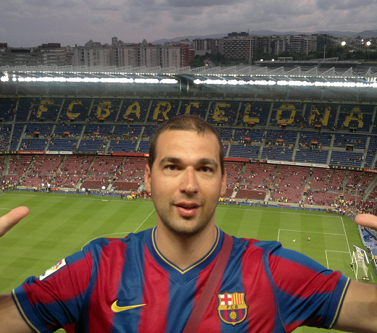





Nikola Ilic
Data-mozart.com
Data Platform Consultant & Trainer
@DataMozart
I'm making music from the data!
Power BI and “all the data things” addict, blogger, speaker...
Father of 2, Barca & Leo Messi fan...

Slide 4

WHAT’S IN FOR YOU?
5 LESSONS LEARNED
BASED ON TRUE STORIES !
Photo by Jhefferson Santos on Pexels.com

Slide 5
WHO IS THIS SESSION FOR?
“NEXT STEP”
Not for rookies!
Advanced power bi practitioners

Slide 6

WHAT NOT TO EXPECT?
NO DATA VIZ WIZARDRY!

Slide 7





DISCLAIMER
Power bi is a “kitchen sink”!

Slide 8
LESSON #1
HYBRID TABLES FOR POOR PEOPLE

Slide 9
SCENARIO
200M FACT TABLE, LOWEST LEVEL OF DETAIL
AGGREGATIONS? HYBRID TABLES? XMLA?
“WHAT IF WE MIMIC HYBRID TABLE BEHAVIOR?”

Slide 10
LESSON LEARNED
CREDIT: PHIL SEAMARK
INSTRUCT POWER BI TO EVALUATE FILTERS BEFORE DATA RETRIEVAL

Slide 11
LESSON #2
NO PREMIUM – NO PROBLEM!

Slide 12
SCENARIO
NUMBER OF CHATS PER PERIOD OF THE DAY
IMPORTED COLUMN AS DATE/TIME
“WORKED FINE IN THE PAST!”

Slide 13
LESSON LEARNED
REDUCE CARDINALITY
FORMATTING DOESN’T CHANGE THE ORIGINALLY STORED VALUES

Slide 14
LESSON #3
LET ME AGGREGATE YOU!

Slide 15
SCENARIO
GIANT FACT TABLE WITH 500+ MILLION ROWS
PERFECT CASE FOR COMPOSITE MODELS
“AGGREGATION AWARENESS?!”

Slide 16
LESSON LEARNED
POWERFUL OPTIMIZATION FEATURE
SOMETIMES ADDITIONAL CONFIGURATION NEEDED
MAKE POWER BI AWARE OF AGGREGATIONS

Slide 17
LESSON #4
SECRET SAUCE OF PROFESSIONALS

Slide 18
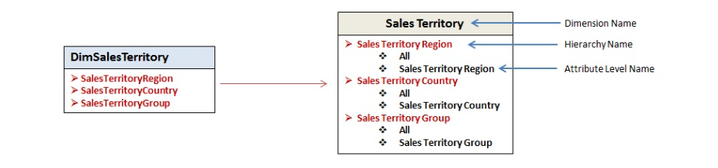

SCENARIO
Power BI is all about DAX, Tabular…
ATTRIBUTE HIERARCHIES
WHICH LANGUAGE DOES EXCEL USE WHEN CONNECTING TO TABULAR?

Slide 19

ISAVAILABLEINMDX
SET TO TRUE BY DEFAULT
WHY NOT FALSE BY DEFAULT?!
MANY POWER BI DEVELOPERS ARE NOT AWARE OF THE PROPERTY!

Slide 20
LESSON LEARNED
HIDDEN GEMS IN TABULAR
INCREASE EFFICIENCY + KEEP FUNCTIONALITIES
WIN-WIN SITUATION!

Slide 21

LESSON LEARNED CONTINUED…
DISTINCTCOUNT, MIN, MAX…
IT DEPENDS ☺

Slide 22
LESSON #5
DINOSAURS, ICE AGE, AND OTHER TRIVIA

Slide 23
HOW DOES IT WORK?
2019-09-15
2023-02-25
2019-01-01
2023-12-31

Slide 24
SCENARIO
SYSTEM-VERSIONED TABLE TRACKS DATA CHANGES
TEMPORAL TABLES (NOT TEMPORARY!!!)
VALID TO: 9999-12-31

Slide 25
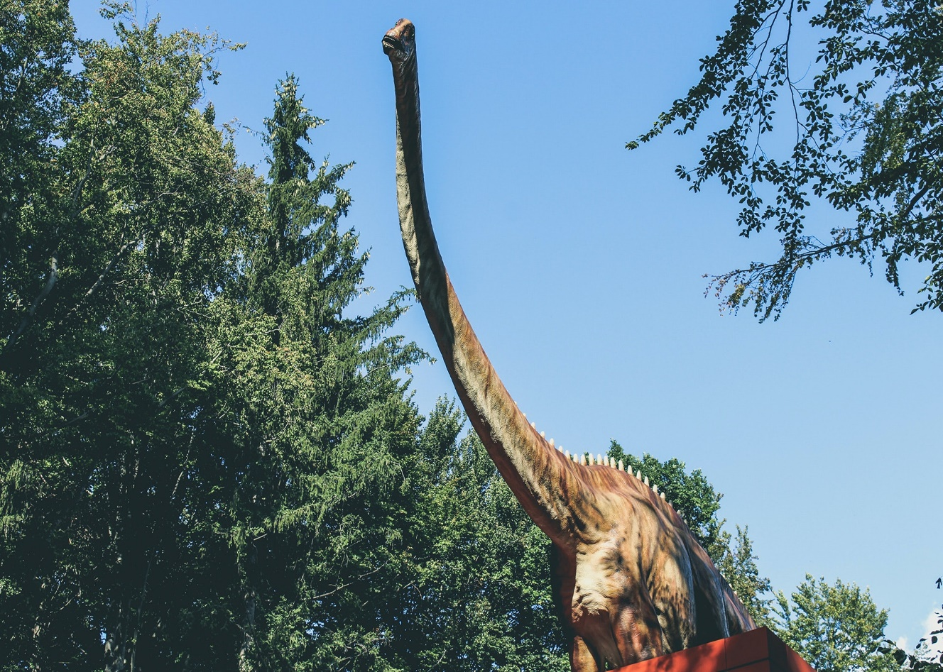

WHO CARES?!
SQL SERVER: 9999-12-31 = 2022-12-31

Slide 26
LESSON LEARNED
DATA MODEL BLOWS AWAY!
ALWAYS USE A PROPER DATE DIMENSION!

Slide 27
LESSONS LEARNED
#1 HYBRID TABLES FOR POOR PEOPLE
#2 NO PREMIUM – NO PROBLEM
#3 LET ME AGGREGATE YOU
#4 SECRET SAUCE OF PROFESSIONALS
#5 DINOSAURS, ICE AGE, AND OTHER TRIVIA

Slide 28

QUESTIONS

Slide 29


THANK YOU!
Data-mozart.com
@DataMozart

